Slide 1
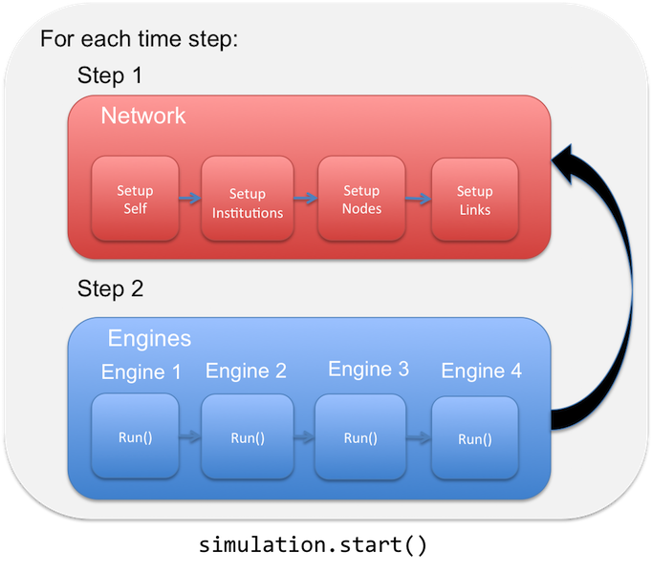
Model Sequence
Simulation setup
Add engines to simulation
Start simulation

Slide 2
Simulation Setup
s = ICOMSimulator() - Create pynsim simulation object, s
s.set_timestep_information() – Add timesteps to simulation, s.timesteps
s.set_landscape() – Add landscape/network to simulation, s.network
s.network.add_institution(CountyZoningManager(name='005’)) – Add example zoning agent, s.network.get_institution(‘005’)
s.network.add_institution(AllHHAgents(name='all_hh_agents’)) – Add categorical institution that contains all household agents, s.network.get_institution(‘all_hh_agents’)
s.convert_initial_population_to_agents() – Convert initial population to household agents, s.network.get_institution(‘all_hh_agents’).components

Slide 3
Add Engines to Simulation:
s.add_engine(RealEstateAssessment()) – Real estate agent performs hedonic analysis on the market (TO IMPLEMENT)
s.add_engine(NewAgentCreation()) - Creates new household agents based on population growth assumptions and adds them to the unassigned queue, s.network.unassigned_hhs
s.add_engine(ExistingAgentReloSampler()) – Identifies existing household agents that want to re-locate and adds them to the relocating queue, s.network.relocating_hhs
s.add_engine(HousingInventory()) – Determines the housing inventory available for each block group, s.network.available_units_list
s.add_engine(NewAgentLocation()) – For each agent in s.network.unassigned_hhs sample 10 available properties and calculate utility, example_hh_agent.hh_utilities
s.add_engine(ExistingAgentLocation()) – For each agent in s.network.relocating_hhs sample 10 available properties and calculate utility, example_hh_agent.hh_utilities
s.add_engine(HousingMarket()) – Matches agents in s.network.unassigned_hhs and s.network.relocating_hhs with top properties.
TBD Engines:
s.add_engine(RealEstate())
s.add_engine(FloodHazard())
s.add_engine(Zoning())

Slide 4
Market Mechanism Concept (based on RHEA):
Owners decide to sell property (hh-sellers) ^{(a)}
Coefficient of hedonic function, i.e., price as function of home attributes (realtor)
Sellers set ask price based on hedonic function (hh-sellers) ^{(b) (c) (d) (e)}
Buyer samples N spatial goods among affordable ones (hh-buyers) ^{(f) (g)}
Buyer ranks the list of N goods according to utility (hh-buyers) ^{(h)}
Buyer calculates WTP for N goods (hh-buyers)
Sellers evaluate the offers and select the highest (hh-sellers) ^{(i)}
Market iterates until all hh-buyers register a trade (market)
The actual annual number of houses going for sale is a random number generated from the normal distribution based on these two. In the future versions of the model this number could be made endogenous. Secondly, households that reside within a flood zone may choose to put their house on sale and look for a home in a safer location, which according to our survey data is more likely to happen when they have experienced a flood. As the simulation goes on, settled households may decide to relocate.
At the beginning of a trading period active sellers announce their ask prices. This is done by combining hedonic regression on housing transactions with spatial interpolation (kriging) of the residuals of the regression. Following de Koning et al. (2016), hedonic regression is run with only a few of the main housing attributes: square footage, acreage, age, number of bedrooms and flood zone location. The residuals of the regression represent most of the location-specific attributes associated with the market value of a property, which is then interpolated over space using kriging.
On top of hedonic analysis and kriging, the algorithm that forms sellers’ ask price takes into account the demand for a segment of a market in the previous time step. For each property, the realtor checks the demand for a group of properties with the same characteristics. The observed demand for these properties relative to the expected demand (at time t-1) determines if the price should be lowered or raised (at time t).
All households in town (homeowners and buyers) update their experience with flooding – a binary true/false variable – after the floods. Housing prices reduce in anticipation of a drop in demand for properties in the flood zones. To capture this in the model, the flood affected sellers reduce their price by 13.8%, and sellers in the 100 year flood zone reduce their price by an additional 15.7% (empirically observed in the survey among sellers).
Homeowners that do have a mortgage will pay off their mortgage linearly in 30 years. This is another important aspect of the model, because it determines whether homeowners are capable of selling their house. If the expected price of their property on the market has dropped below their mortgage debt, for example as a result of a major flooding event, they will abolish their trade attempt. These traders are identified as ‘stuck’ in their homes.
Each time step a number of new buyers enter the market, approximately equivalent to the number of new properties on sale to avoid creating an excess of demand or supply artificially. Buyers randomly choose five properties affordable for their housing budget which varies across households. Insurance influences buyers’ decisions first in this phase. In the model with 100% insurance uptake, buyers limit their budget for properties in the flood zone to reserve fund for insurance costs
Buyers have subjective perceptions of risk, which are dynamic over time. Their risk perception variables determine whether buyers avoid buying properties in the 1:100 and 1:500 year reoccurring flood zones. This affects the demand for risk-prone properties.
Their utility for owning a property depends on a bundle of property attributes, neighborhood quality and a potential exposure to flood hazard. The base multi-attribute utility function (U0L, Eq.4.1) for a house in a safe area is parameterized using weights (Ai) that reflect relative importance of each characteristic (Xi,norm): 𝑈_{0𝐿}=𝐴_{𝑖}∗𝑋_{𝑖,𝑛𝑜𝑟𝑚}
The transaction price is defined through a price negotiation procedure, which is based on bid and ask prices and relative market power of traders

Slide 5
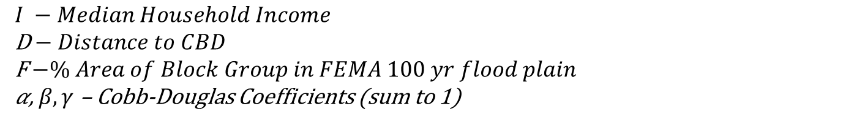
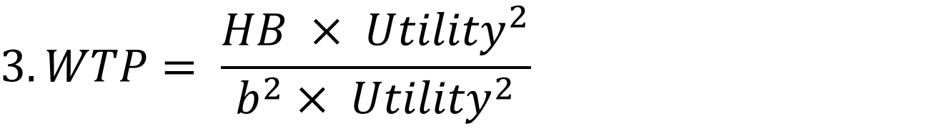
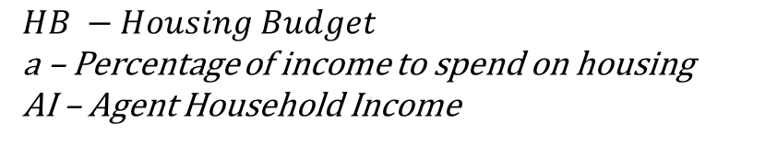
Simple Household Cobb-Douglas Utility Function:
$$1. HB=a ∗AI$$
$$HB −Housing Budget$$
a – Percentage of income to spend on housing
AI – Agent Household Income
$${2. Utility}_{agent, bg}= I^{α}×D^{β}×F^{γ}$$
$$I −Median Household Income$$
D$− Distance to CBD$
F$−\% Area of Block Group in FEMA 100 yr flood plain$
𝛼, $β, γ$ – Cobb-Douglas Coefficients (sum to 1)
$$3. WTP= \frac{HB × {Utility}^{2}}{b^{2}× {Utility}^{2}}$$
$$WTP −Willingness to Pay$$
b – WTP Coefficient

Slide 6
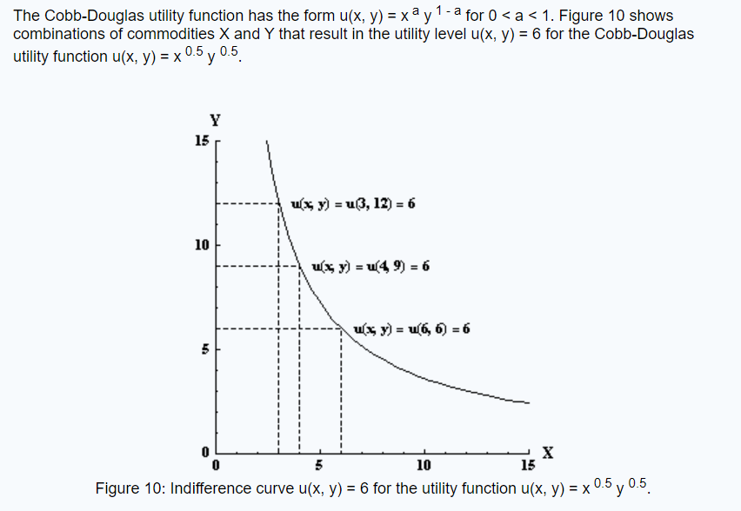
Simple Household Cobb-Douglas Utility Function:

